Slide 1
User-defined data types
2017 first semester
Basis and Practice in Programming

Slide 2
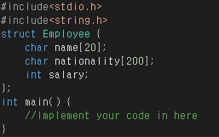
Practice 1
Through given ‘Employee’ structure, make the employee information registration program.
Ask whether user want to enter employee information.
’yes’ -> receives input in name, nationality and salary
’no’ -> print all entered employees and exit program.
Assume that the number of total employee is 100.

Slide 3
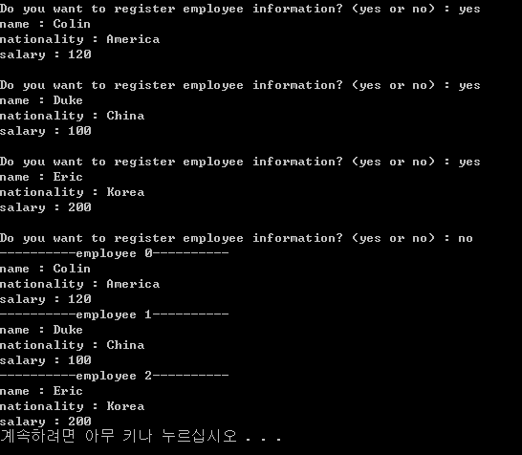
Practice1 - Example

Slide 4
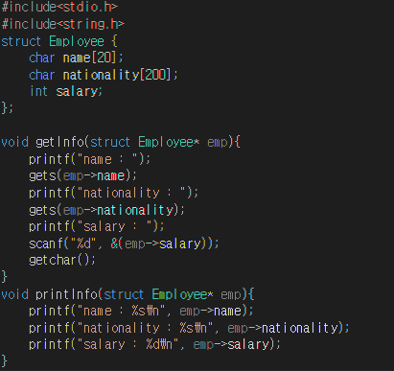
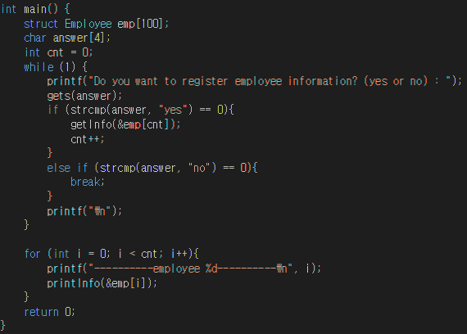
Practice1 - Solution

Slide 5
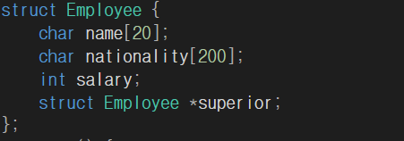
Practice 2
Using Practice1
Assume that each employee has one superior or not.
When employee information is registered, ask that he/she has a superior
‘yes’ -> register superior information
‘no’ -> Repeat again.

Slide 6
Employee 1
Eric, Korea, 120
Superior
Eric’s Superior
Alex, America, 150
Employee 2
Billy, China, 120
Superior
Billy’s Superior
Robert, America, 120
Employee 3
Ted, America, 130
Superior
NULL

Slide 7
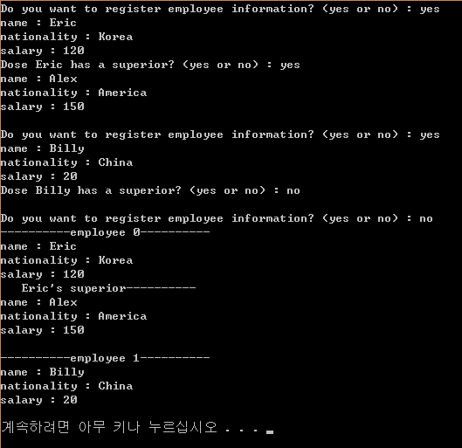
Practice2 - Example

Slide 8
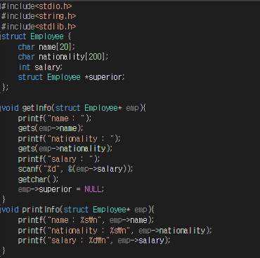
Priactice2 - Solution

Slide 9
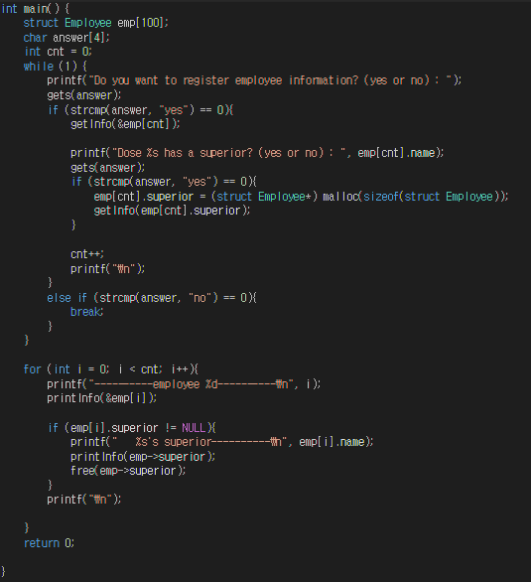

Slide 10
Practice3
Using practice2
The superior can also have superior too.
Employee 1
Eric, Korea, 120
Superior
Eric’s Superior
Alex, America, 150
Superior
Alex’s Superior
Employee 2
Robert, America, 170
Superior
. . . . .
Billy, China, 120
Superior
Billy’s Superior
Ted, America, 120

Slide 11
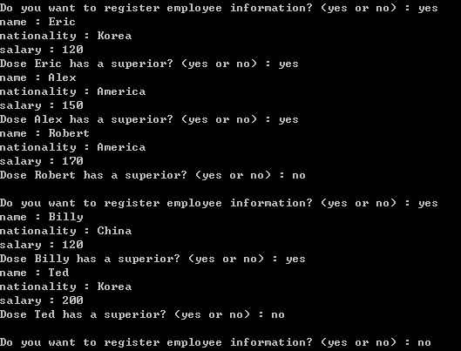
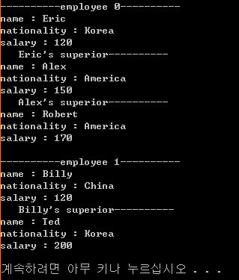
Practice3 - Example

Slide 12
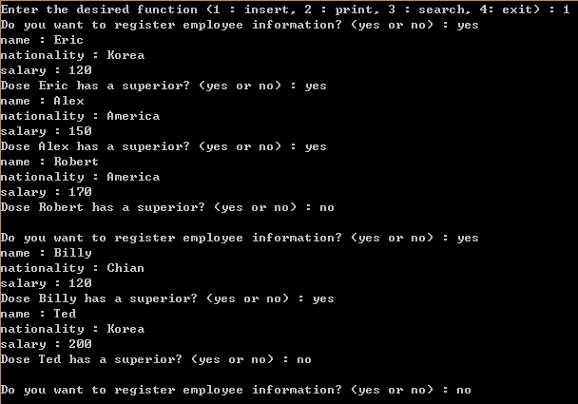
Appendix 1
Expand your practice code and create a ‘search’ function

Slide 13
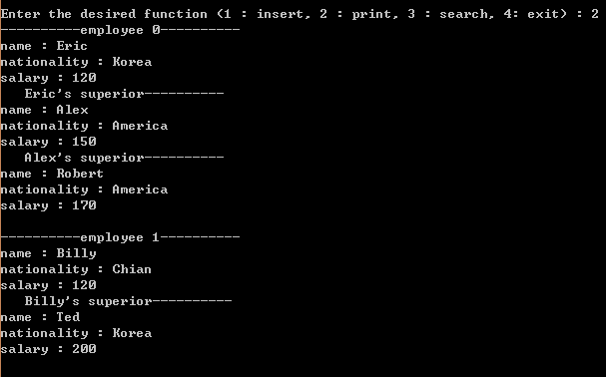

Slide 14
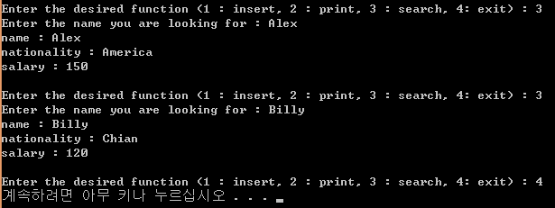

Slide 15
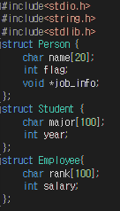
Appendix2
Save the information of person who is a student or employee in the Person structure
If who is student, assign Student structure to job_info variable by using memory allocation function
If who is employee, assign Employee structure to job_info variable by using memory allocation function
The total number of person is 100.

Slide 16
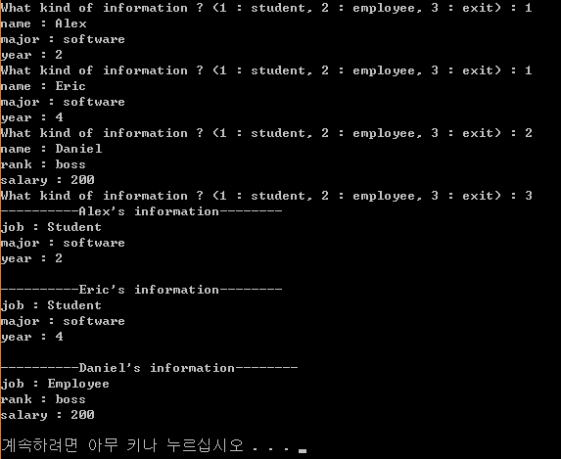
Appendix2 - Example

Slide 17
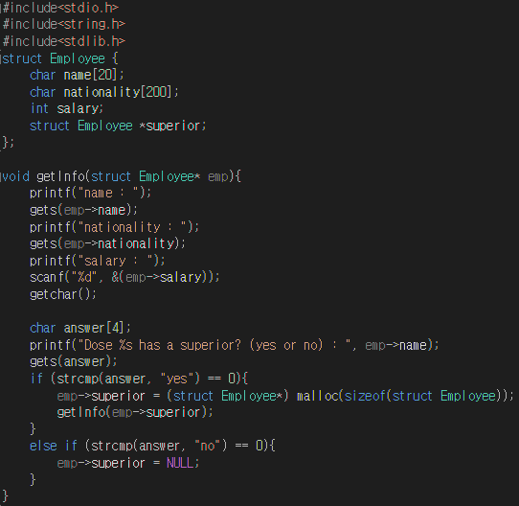
Practice3 - Solution

Slide 18
